Slide 1
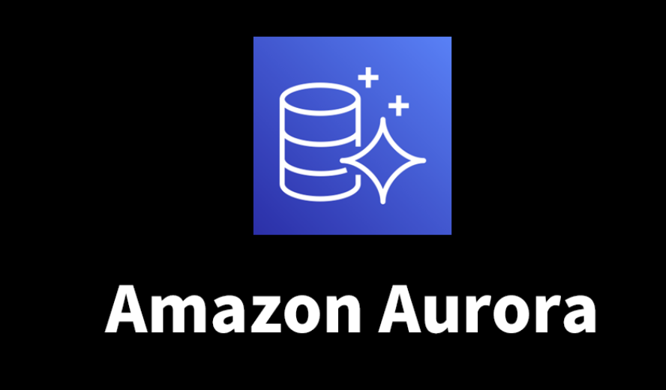

What I Learn About NodeJS During
Write Forwarding Benchmarking
by naor tedgi (Abu Emma)

Slide 2
The Goal: i want to determine if we can move all our services to us
and using write forwarding to write data from all our applications

Slide 3
as you know we really wants to move all our infrastructure to US
Today our Mysql Writer Located in EU and shared
with supply and delivery
today the services deployed in US (offline-js) using Mysql readers located in US to read and Write-Forwarding in order to write

Slide 4
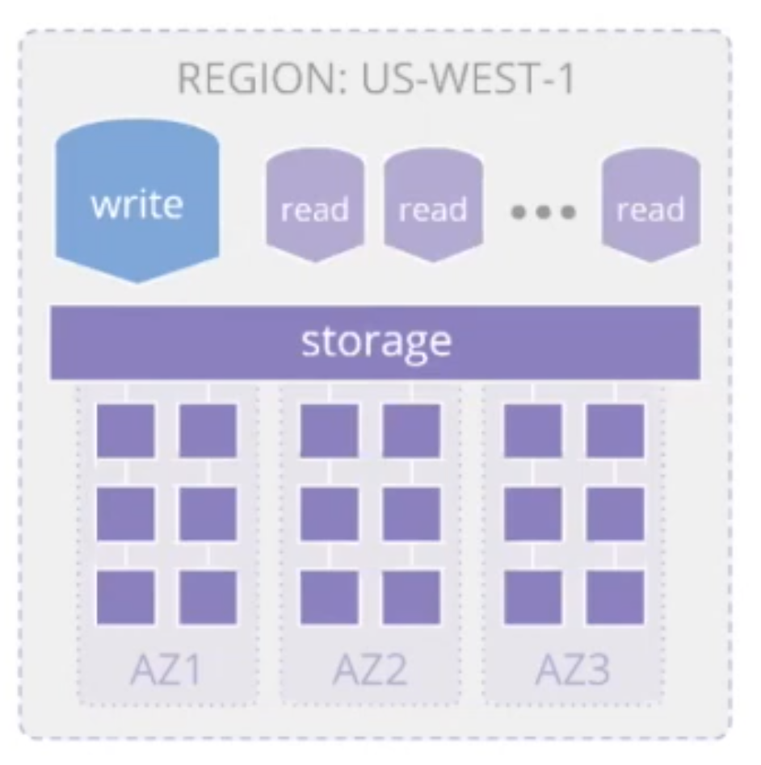
what is write Forwarding?
write layer, read layer, storage layer
qurum reading

Slide 5
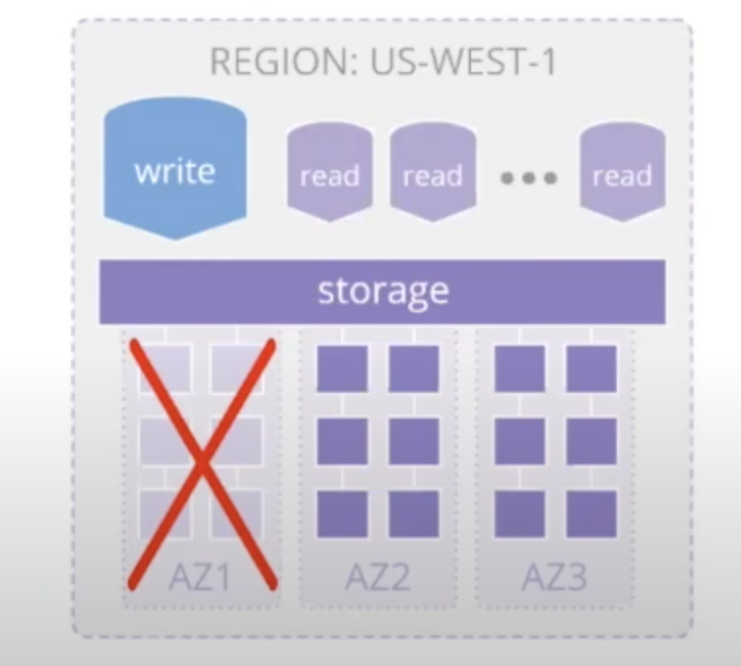
what is write Forwarding?
write layer, read layer, storage layer
qurum reading

Slide 6
what is write Forwarding?
write layer, read layer, storage layer
qurum reading

Slide 7
what is write Forwarding?
your applications can simply send both read and write requests to a reader in a secondary Region, and Global Database will take care of forwarding the write requests to the writer in the primary Region.
`SET aurora_replica_read_consistency = GLOBAL`

Slide 8
Benchmarking - TRY 0
1. Make the simplest code you can to simultate your case
100 insert , 100 Delete , 100 Update , 100 select
update a map with counter that calculate how many queries run
and how much time it takes for example {delete:{total:50:totalTime:1342s}}
using Event Emitter
2. Run code multiple times
3. Always calculate the average of X Runs and not single
4. Repeat X times
run from my local PC

Slide 9
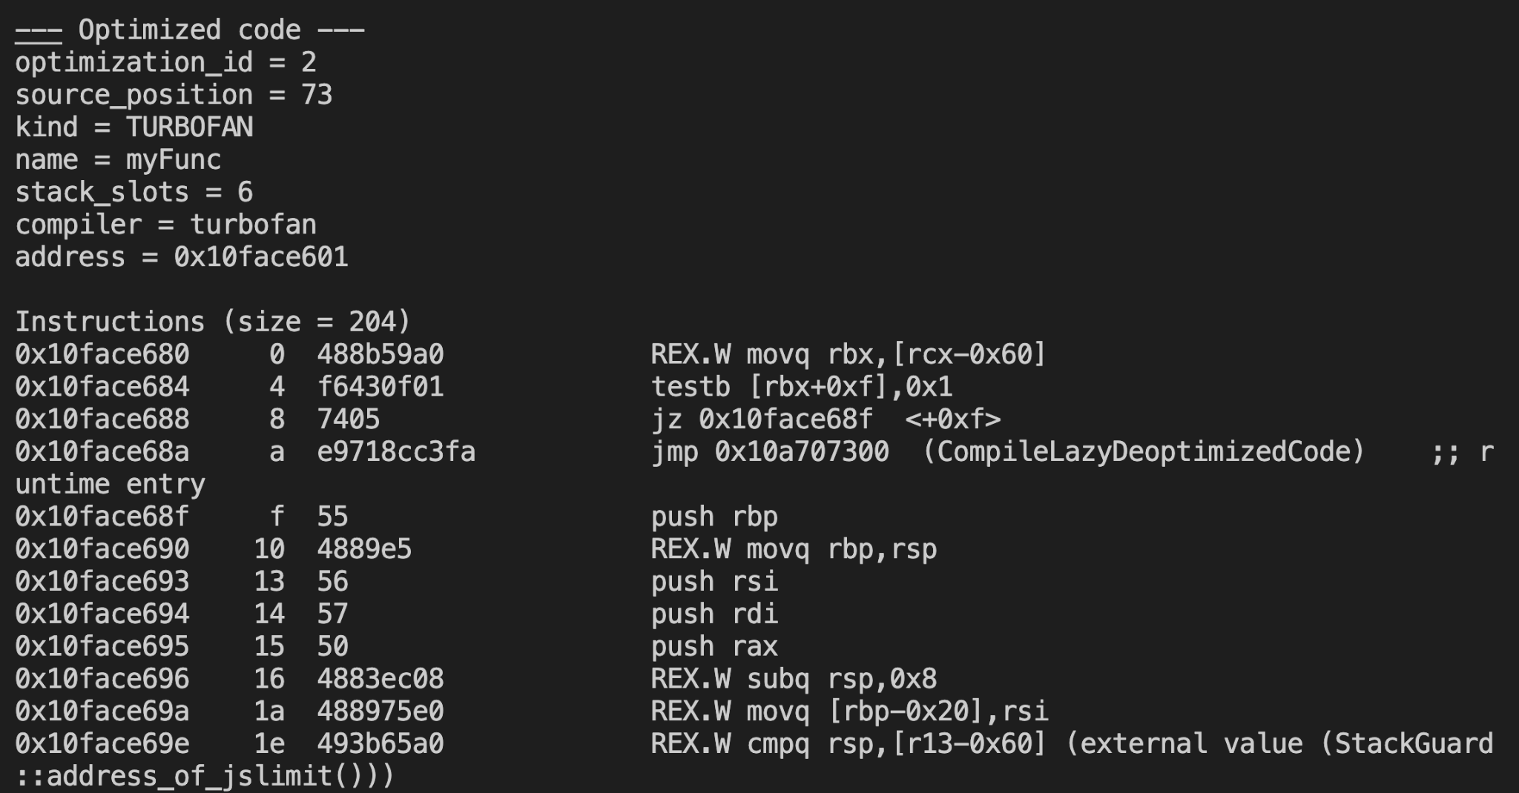
Run code multiple times JIT COMPILER (Run: node --print-opt-code example.js)
const ITRATIONS = 200000
function myFunc(obj) {
return obj.x ;
}
const obj1 = { x: 1 }
for (let i = 0; i < ITERATIONS; ++i) {
myFunc({ ...obj1 });
}

Slide 10
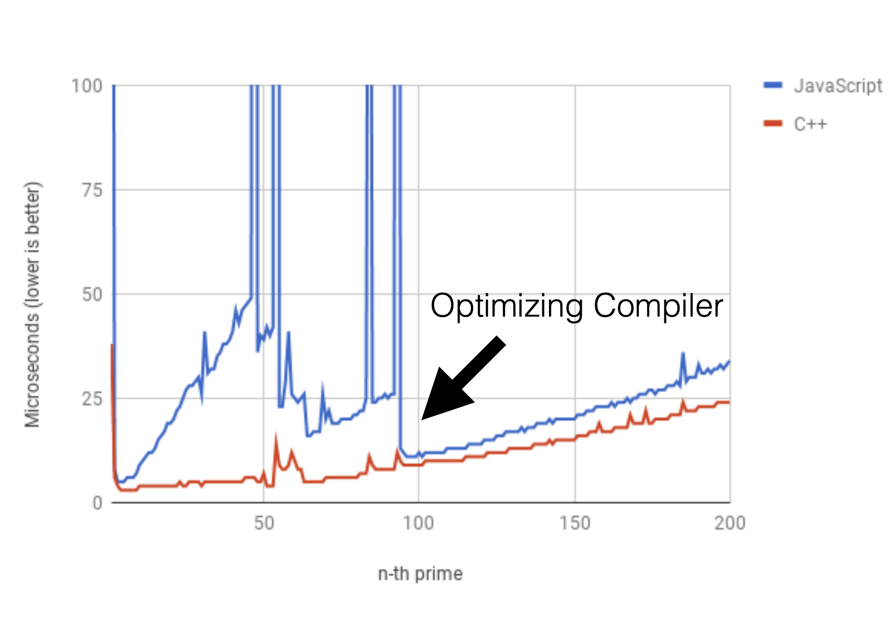
Run code multiple times
The reason : Shape File Cache And Hidden function, Not going to dive in only if you want me to

Slide 11
Run code multiple times
C++ AddOns , WebAssembly packages takes a lot of time to load

Slide 12
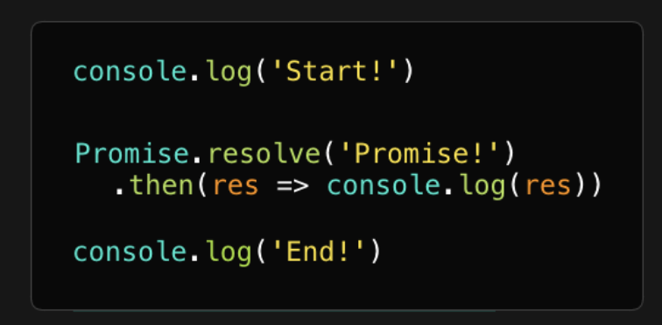
TRY 0 : conclusions - Failure (WF is not stable)
after 10-15 seconds A lot of queries failed with error timeout and the process crush
for The queries that work the time was almost X2 in US
The Problem Was with Promise.all()
question what is the order here of printing?

Slide 13
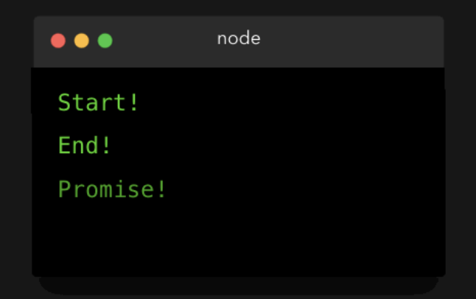
TRY 0 : conclusions - Failure (WF is not stable)
after 10-15 seconds A lot of queries failed with error timeout and the process crush
for The queries that work the time was almost X2 from running in from EU
The Problem Was with Promise.all()

Slide 14
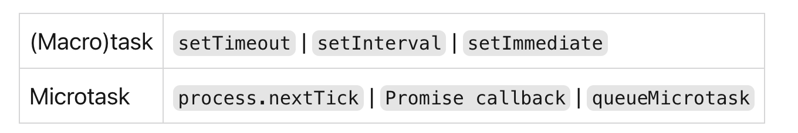
All functions in that are currently in the call stack get executed. When they returned a value, they get popped off the stack.
When the call stack is empty, all queued up microtasks are popped onto the callstack one by one, and get executed
when i ran Promise.all in it takes a lot of time to resolve i wasted a lot of time on Garbage collection instead on running the query
i add throttling to the procedure instead of creating 1000 queries at the same time i restrict it only to 10 running together

Slide 15
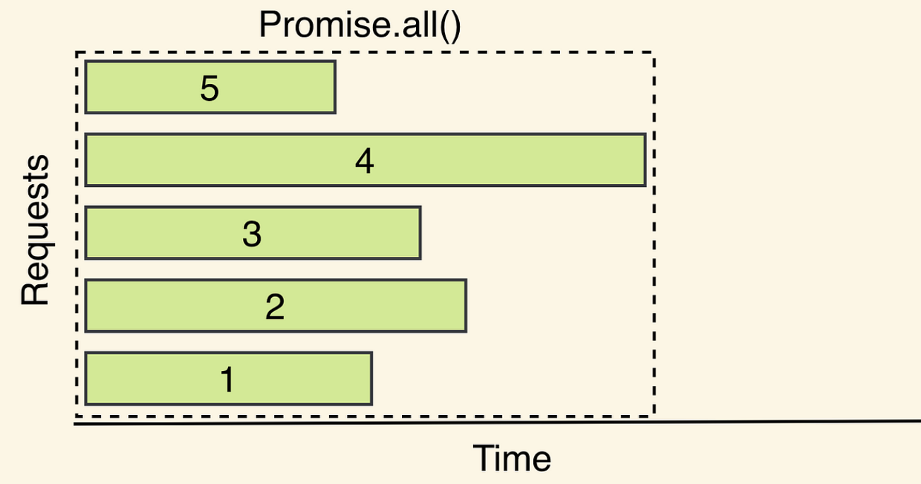

Slide 16
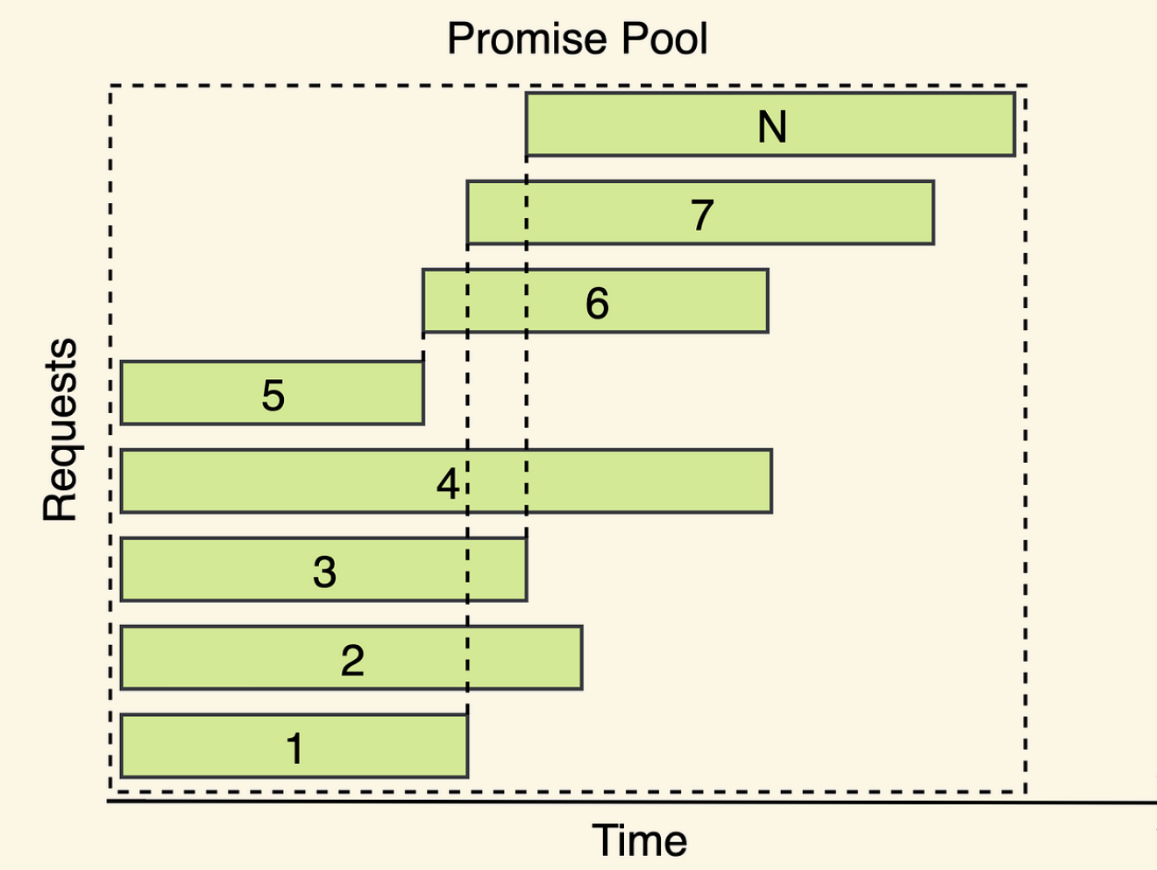

Slide 17
TRY 1 : conclusions - Stable - but running slow
the experiment isn’t correct because i ran it from my local PC to EU And US
i saw the difference from eu to us have 2 second for each query
when i write the benchmark i set aurora_replica_read_consistency
for every query at the US WF - result is when running the experiment on US
i run 2X queries 1 for the set 1 for execution
i split the mysql connection pool to read and write connection and set the Wf variable on the query creation

Slide 18
TRY 1 : conclusions - Stable - but running slow
const newConnectionHandler = (connection: mysql.PoolConnection, mode: string) => {
if (process?.argv[2] === "us" && mode === "write") {
console.log("set aurora_replica_read_consistency to openXPool connection created");
connection.query("SET aurora_replica_read_consistency = 'session'");
}
console.log("openXPool connection created");
connection.on("error", (err: any) => {
console.error("openXPool connection error:", err);
});
};
writeOpenXPool.on("connection", (connection) => {
newConnectionHandler(connection, "write");
});

Slide 19
TRY 2 :
i ran the experiment from a machine in US
i add connection pool for Write and Read
i remove the first iteration from average because i need to create more connection then in EU and it was 4x time slower than other iterations

Slide 20
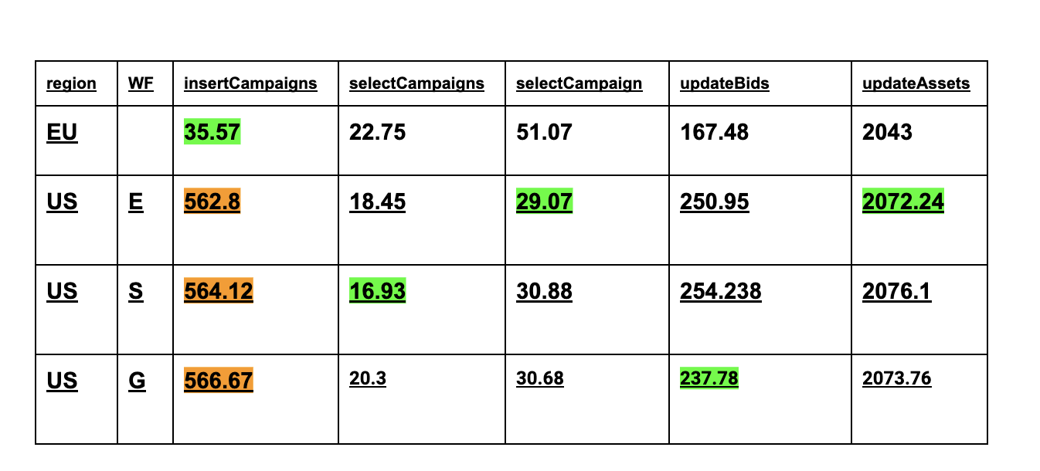
TRY 2 : Looks Great Except Insert campaigns
i ran the experiment from a machine in US
i add connection pool for Write and Read
i remove the first iteration from average because i need to create more connection then in EU in it was 4x time slower than other iteration

Slide 21
TRY 2 : Looks Great Except Insert campaigns
i thought it’s ok and that is the best we can get
then after talking with ofir from elad’s team he talled me i have a problem with the insert campaign statement because i am running 50 insert queries in parallel
i am wasting a lot of time waiting for locks!! and in aurora it even worse
https://docs.aws.amazon.com/AmazonRDS/latest/AuroraUserGuide/aurora-mysql-write-forwarding.html
In sessions that use write forwarding, you can only use the REPEATABLE READ isolation level. Although you can also use the READ COMMITTED isolation level with Aurora Replicas, that isolation level doesn't work with write forwarding. For information about the REPEATABLE READ and READ COMMITTED isolation levels, see Aurora MySQL isolation levels.

Slide 22
TRY 2 : Looks Great
i ran the experiment again this time i shuffle the queries and keep them at the same order for both benchmarking
that way i avoid the lock time
Math.random = () => {
const x = Math.sin(seed++) * 10000;
return x - Math.floor(x);
};

Slide 23
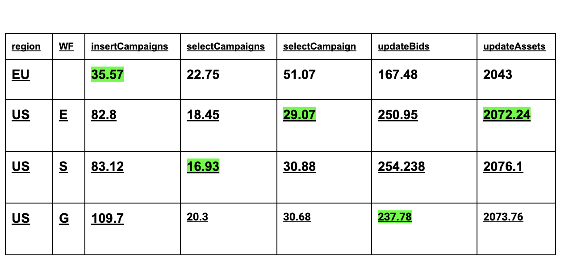
TRY 2 : Looks Great

Slide 24
Summary
1. Make the simplest code you can to simultate your case
2. Run code multiple times
3. Always calculate the average of X Runs and not single run
4. Repeat the entire experiment X times
5. Check runtime factors not impacting your experiment
6. Use the same logic you are going to use in production (connection pool)

